Slide 1

“Accept All”
The Landscape of Cookie Banners in Greece and the UK
Georgios Kampanos & Siamak F. Shahandashti
University of York

Slide 2
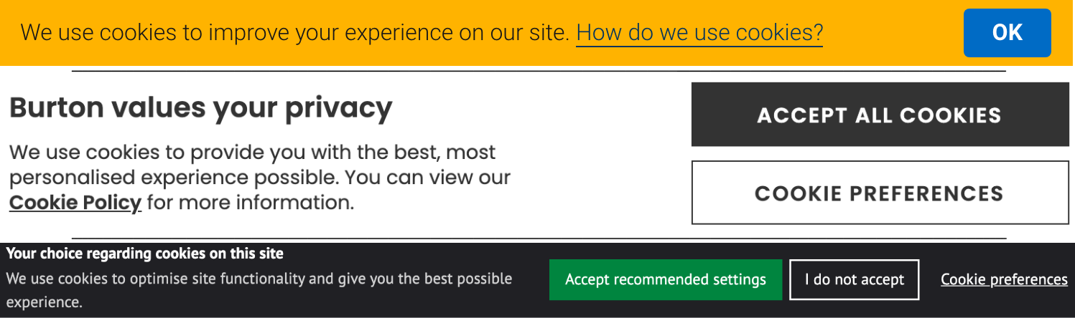
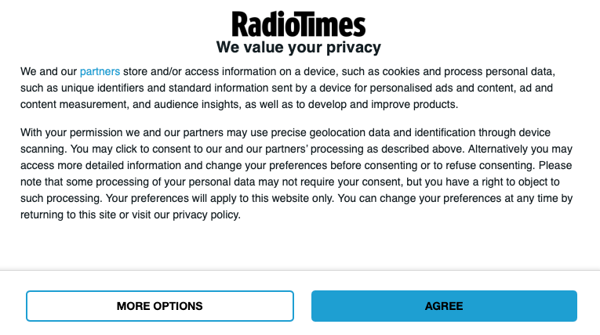
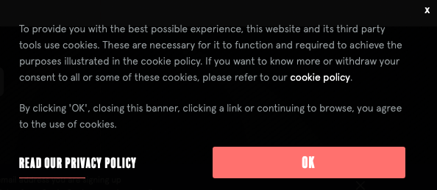
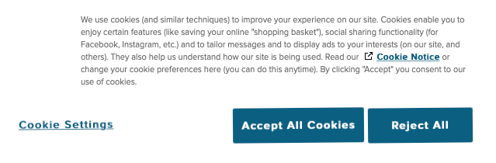
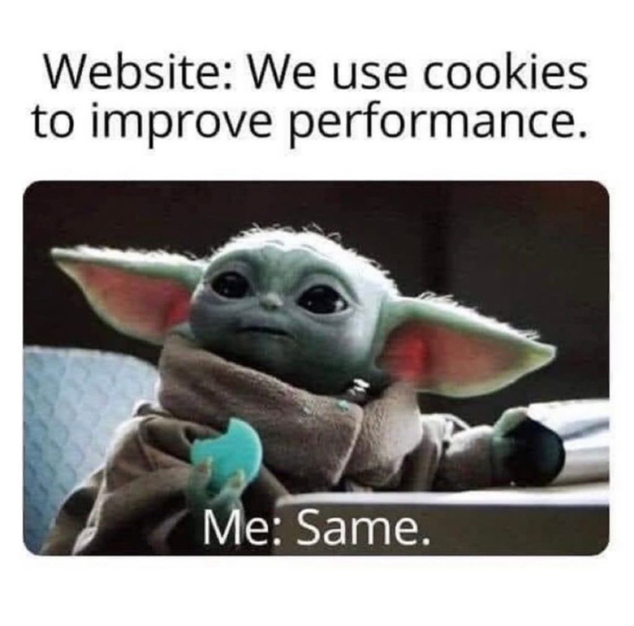
Probably the most hated element of the internet
Some examples

Slide 3

Why so many cookie notices?
Cookie banners are everywhere
Because of legislation such as the GDPR and the DPA (UK) websites are required to inform their users about 3rd party cookie tracking.
They exist for a good reason!
They should allow users to manage their privacy and opt-out from tracking.
However, we did notice “dark patterns”
For example: pre-selected options, hard-to-find or non-existent opt-out buttons etc.

Slide 4















Relevant research on cookie banners
1,427 website survey
1,000 website manual survey
141 websites registered an affirmative consent before the user had performed any actions and 38 websites offered no opt-out option at all.
27.8% of websites provide no options, 68.0% allow confirmation only, while only 3.2% give a binary accept/reject choice
Matte, Bielova and Santos
Utz et al.
150 website survey
6,759 website survey
680 website survey
Cookie banner adoption across the EU go up from 46.1% before the GDPR to 62.1% afterwards
89% websites with targeted advertising offer a way to opt-out
32% of websites assumed implicit consent which makes them not-compliant with GDPR
Habib et al.
Degeling et al.
Nouwens et al.

Slide 5

Adding Scale
Previous research is small-scale
None goes beyond 700 websites in the two countries that we take into consideration.
What if we go bigger?
Do similar trends appear if the scale of the sample size is increased? It is not clear whether characteristics observed in high-traffic websites remain similar if low-traffic ones are considered.
Go big in two countries!
We focused on two specific countries: the UK and Greece, but scaled up the sample size nearly ten-fold by automating our scraping and analysis.

Slide 6

Research Questions
1
Prevalence of cookie banners
4
Privacy settings and controls
What is the prevalence of cookie banners across the board when less popular websites in Greece and the UK are also considered?
What proportion of cookie banners allows their users to manage their privacy settings and control which vendors track them?
2
Distribution of options
5
Comparing the two countries
How does the distribution of options offered in cookie banners look like and what proportion of websites provide a direct cookie rejection option?
How do the two countries compare in terms of the privacy options offered by cookie banners?
3
Implicit consent
What proportion of websites employ implicit consent?

Slide 7






Methodology
Gather Websites
Collect Cookie Banners
Santising and normalising data
Used Tranco + country-specific lists to build our dataset
Extended OpenWPM to effectively detect + store cookie notices
Tranformed arbitrary code to a consistent data structure for efficient queries
Ethical considerations
Software + Tools
Process
1
Robots.txt parser
1
OpenWPM
1
Convert HTML to JSON
2
TOS parser
2
IDCAC
2
Manually identify categories
TERMS OF SERVICE
I DON'T CARE ABOUT COOKIES LIST
AFFIRMATIVE, NEGATIVE, INFORMATIONAL, MANAGERIAL
3
Purpose-built Cookie Parser
4
SQLite

Slide 8



The 4 Privacy Categories
description & examples
Affirmative
Options that prompt users to accept the use of cookies, e.g. "accept", "agree", "allow", and "OK"
Negative
Options that allow users to opt-out from cookie tracking, e.g. "decline", "reject", "disagree", "no"
Managerial
Options that allow users to opt in/out of specific trackers, "manage", "settings", "vendors/partners"
Informational
Options that take users to informational pages, e.g. "Privacy Policy", "learn/see/read more"

Slide 9




Dataset Size
Breakdown of the number of websites per country that are included (by source) and excluded (by reason).
Greece
UK
Combined
Included from Tranco
3,446
18,768
22,214
Utilised Viking, University of York's supercomputer to run our software
Included from country-specific lists
40
634
674
Excluded due to unavailability
-125
-$305
-430
Using 128GB of memory and 32 cores the crawl was completed in 8~hours for Greece and just over 36~hours for the UK!
Excluded due to robots.txt
-204
-3,687
-3,891
Excluded due to Terms of service
-70
-760
-830
Total
3,087
14,650
17,737

Slide 10
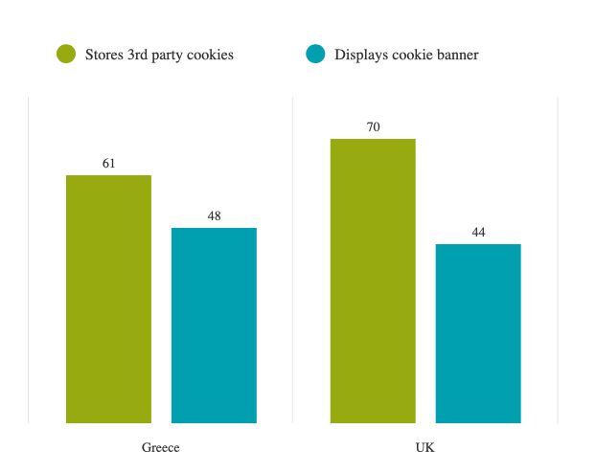
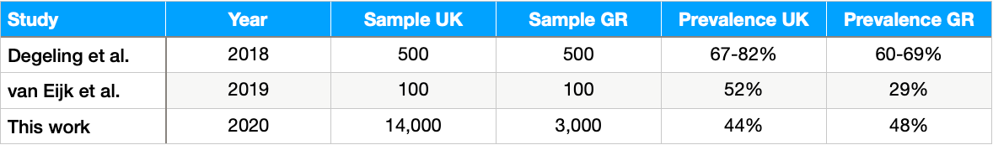
Research Question 1
Prevalence depends on sample size
46%
Of websites display a cookie banner
This is at odds with previous, smaller-scale research on the subject. Our results demonstrate that the observed prevalence depends on the size of the sample. Our data suggests that around 13% of Greek and 26% UK websites have yet to comply with the GDPR or DPA.
Type text

Slide 11
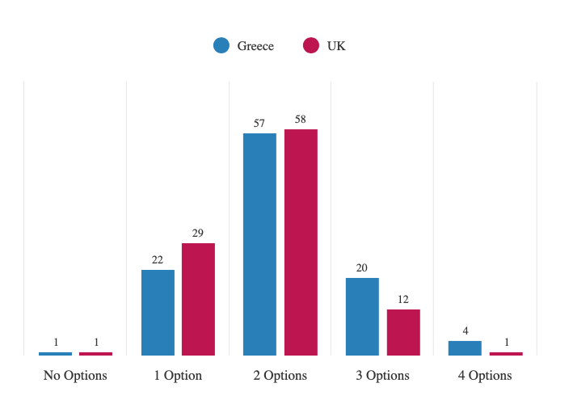
Research Question 2
Users might not have many options available
2 privacy options
on average per cookie banner
This is in agreement with van Eijk et al.'s finding that the median number of choices in the top 100 popular websites that have a cookie banner in both countries was two.

Slide 12
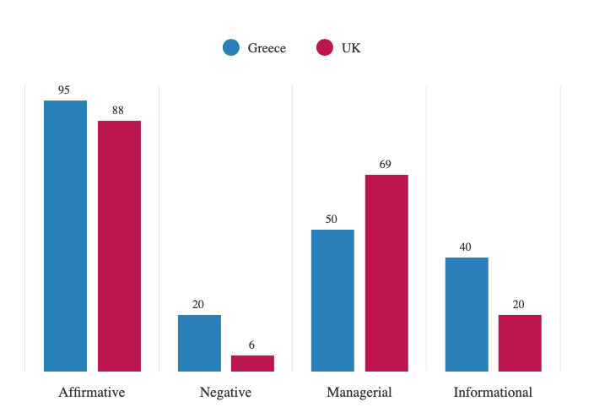
Research Question 2
Direct opt-outs are rare
Impossible to opt-out?
A considerable proportion of cookie banners provide either no option or only one option to the user.
Although Affirmative options are quite ubiquitous in both countries (Greece: 95%, UK: 88%), Negative options are quite rare (Greece: 20%, UK: 6%) making it hard or impossible to opt-out from tracking.

Slide 13


Research Question 3
Most cookie banners nudge towards privacy-intrusive choices
Combos
GR
UK
Consent Explicit
Accept easy as Reject
ANMI
4%
1%
Compliance
ANM-
5%
3%
AN-I
10%
< 1%
AN--
2%
1%
Our research confirms what other researchers also found: Websites nudge users towards accepting cookies.
A-MI
5%
8%
Νο
A-M-
32%
47%
Νο
A--I
21%
8%
Νο
A---
17%
19%
Νο
-NMI
< 1%
0%
It is also clear 76% of Greek and 84% of UK cookie banners violate the GDPR and DPA!
-NM-
< 1%
<1%
-N-I
0%
0%
Νο
-N--
0%
0%
Νο
--MI
< 1%
1%
--M-
4%
9%
---I
1%
1%
Νο
Νο
----
< 1%
1%
Νο
Νο

Slide 14
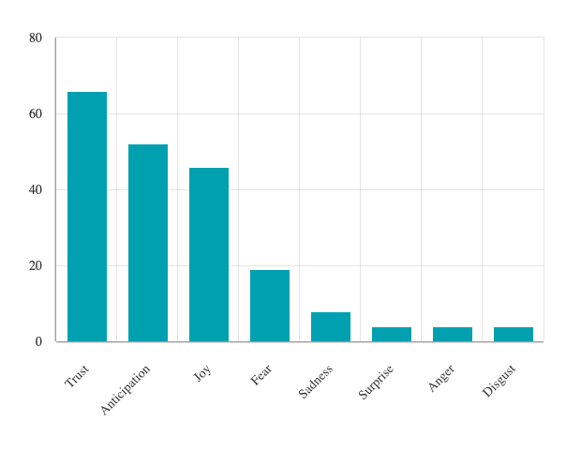



Research Question 3
Have some cookies, they are good for you!
Distributions of the emotional affects in the UK cookie banner text corpus
14%
Positive
6%
Negative
Other
80%

Slide 15









Research Question 4
Managing tracking is more prevalent than opting out
Greece
With Manage Btn
Without Opt-Out
More clicks to opt-out
59%
80%
Without Manage Btn
With Opt-Out
41%
20%
Specifically, 59% of Greek and 69% of UK cookie banners offer a Managerial option compared to 20% and 6%, respectively, with a Negative one.
United Kingdom
With Manage Btn
69%
Without Opt-Out
94%
Users in both countries are several times more likely to be given an option to manage their cookies than an option to decline them.
With Opt-Out
Without Manage Btn
6%
31%

Slide 16

Research Question 5
Users in both countries lack real choice, but practices vary.
Similarities
Differences
Prevalence of cookie banners
Widespread deployment of third-party cookies
Rampant use of nudging and other dark-patterns
Greek websites tend to be more compliant with regulations and tend to provide slightly higher number of options
Affirmative options are prevalent in both, but negative options are much scarcer in the UK
Managerial options are more prevalent in the UK and informational ones more in Greece

Slide 17

Conclusion
A large scale study
Opting-out is very hard
We set out to conduct the most comprehensive study of cookie banners in the UK and Greece to date.
Only a minority of websites offer a direct opt-out option.
Cookies for a better internet?
Scale
websites present cookies as devices that improve browsing experience for the user while the negative aspects of tracking tend to be downplayed.
By extending OpenWPM to detect and store cookie banners, over 17,000 websites were crawled and more than 7,000 cookie banners were collected.
Prevalence
~50% of websites show cookie notices but a substantial porpotion does not even though they use 3rd party cookies.

Slide 18


Questions
Georgios Kampanos & Siamak F. Shahandashti

